Slide 1
Driver’s tiredness symptom detection and warning
By Tolu Abolude

Slide 2
Overview
Brief Project Update
Parameters to be measured
Layout of Python System
Measuring Eye State parameters
Measuring Mouth State parameters and Head Posture Parameter using Bimodal Deep Neural Network based on landmark and Texture (Future Work)

Slide 3




Brief Project Update
Drowsiness is a feeling of being sleepy when you are not meant to (state between vigilance and rest).
According to available statistics 30% of road accidents occurs due to drivers sleeping while driving.
Measures have been suggested to determine driver drowsiness such as vehicle-based measures, behavior measures and physiological measures. However I will be focusing on behavioural measures because it is accurate and less intrusive to drivers when used compared to the other two.
The aim of my project is to provide a python system with the aid of available python libraries like OpenCV to detect and warn tired drivers when drowsiness is detected.

Slide 4
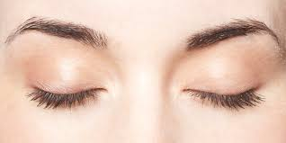
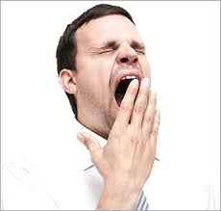
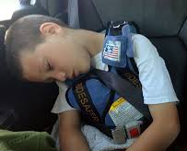
Parameters to be measured
To achieve this project’s objective I will observe the following:
Eye State Parameter (close eyes)
Mouth State Parameter (Yawning)
Head Posture Parameter (Hang their head and looking left or right frequently)

Slide 5
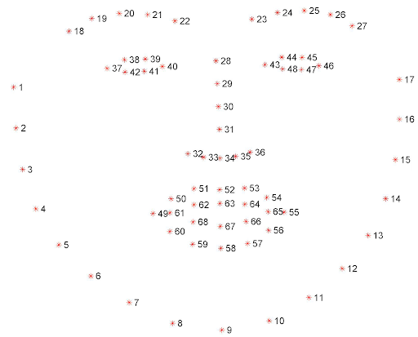
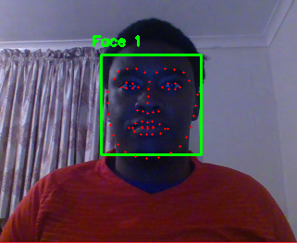
Layout of Python System
I have broken the implementation of this project into the following steps:
The python system will take an image or video as input to be processed.
Face is detected and facial landmarks are assigned to the input.
The facial landmark are used to measure eye aspect ratio (EAR).
Use Bimodal Deep Neural Network based on landmark and Texture i.e. stacked Autoencoder to classify yawning and head posture as well as facial expression.

Slide 6
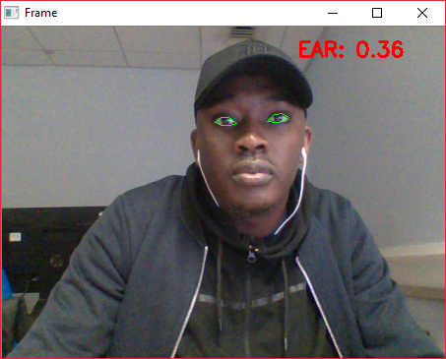
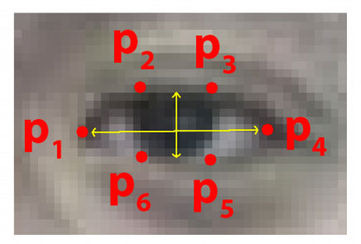
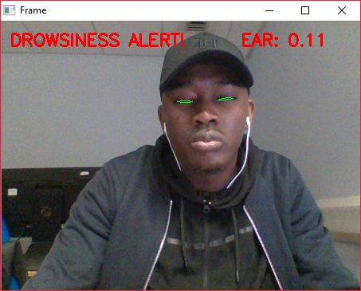
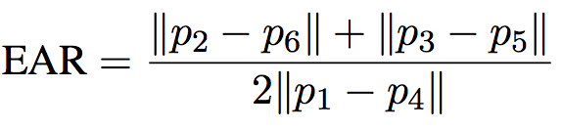
Measuring Eye State parameters
This is fig shows when the ‘driver’ is awake i.e. eyes are open
Notice that the values of EAR reduces when the your eyes are closed. This is because of the following equation:
This is fig shows when the ‘driver’ is asleep i.e. eyes are closed

Slide 7
Measuring Mouth State parameters and Head Posture Parameter
I will use Deep learning (Bimodal Deep Neural Network i.e. stacked Autoencoder) for these measurements because they outperform other ML algorithms in domains such as image classification.
It allows a system to learn complicated representation directly from trainset data. Creating accurate classifications.
The Idea is to take an image of the subject (driver) yawning or facing left or right and label this behaviour.
Future Work:
Make a python system that takes images and classifies it as yawning or any head posture if applicable. (3 weeks.)

Slide 8


Thank you and any question

